Slide 1




Slide 2


Volunteer State Community College is proud to partner with your school system to provide an opportunity for academically talented students to earn college credit while still in high school. Dual enrollment helps students remain engaged in high school and helps prepare them for college-level curriculum. Successful course completion allows the student to earn high school credit and college credit for the same course.
Courses are mainly offered at the high school campus during the regular school day and follow the high school calendar as closely as possible. Additionally, students in some school systems, are able to take classes on Vol State's campus or online.

Slide 3


Enroll in college courses taught at your high school, online or at VSCC
Transition from high school to college more easily
Lower college expenses by reducing the amount of time spent in college
Access college resources and services such as advising, career counseling and mentoring
Take general education courses and transfer those credits to any public Tennessee college or university
Able to receive a college ID
Complete Prerequisites required for desired degree program
(Ex. Nursing, Veterinary Technology, Radiologic Technology, Respiratory Care, etc.)

Slide 4



Volunteer State Community College provides dual enrollment courses in a variety of formats including:
Face-To Face classes taught at local high schools by Vol State faculty
Face-To Face classes taught at local high schools by high school teachers who are also credentialed to teach college-level courses and serve as qualified Vol State adjunct faculty.
Online courses taught by Vol State faculty
Day and evening courses taught at VSCC Main Campus or at one of the
College’s off-site locations
Talk with your school counselor to check what options are available to you.

Slide 5

New students interested in dual enrollment must meet the following criteria:
  Junior or Senior in High School – Note: exceptions can be made for high achieving underclassmen
  Acceptable placement scores or GPA – Note: ACT and Accuplacer exams are the only acceptable placement tests
  Receive permission from high school counselors
  Receive permission from parents/guardians
  Complete an online application to VSCC
  Satisfy all admission requirements prior to registering for classes
Note: if a student has not taken the ACT or needs to take a challenge test,
they must complete the ACCUPLACER exam by the testing deadline.
Fall testing deadline: 06/15 with results due to college no later than 6/30
Spring testing deadline: 12/15 with results due to college no later than 12/30
Priority Registration Deadline is May 31
Placement Type | English/Writing | Reading | Math
ACT | 18 | 19 | 19
Accuplacer | 250 | 250 | 250
Cumulative GPA | 3.6

Slide 6

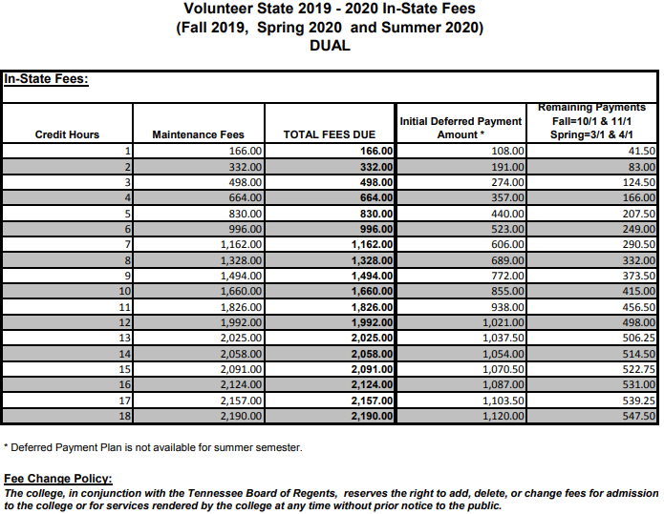

Slide 7




Students are responsible for cost of course textbooks and course material. The cost of books varies by course.
Some courses may have an IncludeEd (eBooks) fee automatically added to the student’s billing account. The students have the option to purchase a hardcopy of the book for a discounted rate through Follett. Student has the option to Opt-out. Important to check with your instructor regarding required textbook.
Pricing ranges from $20-$100 per textbook

Slide 8


Dual enrollment students are eligible for the Tennessee Dual Enrollment Grant. To be eligible for a Dual Enrollment Grant for any semester beyond the first semester of receipt, the student must continue to meet all eligibility requirements for the grant and must achieve a cumulative grade-point average (GPA) of 2.75 for all postsecondary courses
Dual Enrollment Grant = 2 FREE Classes
Grant covers a maximum of 2 courses per semester
Starting with their 5th course, students have the option to deduct from their HOPE Scholarship.

Slide 9

Grant-Funded Course Number | Dual Enrollment Grant | Course Fees Paid by the Student
1 | Up to $500 | 3-hour course= $0
2 | Up to $500 | 3-hour course= $0
3 | Up to $200 | 3-hour course=$298
4 | $0 | 3-hour course=$498
5 (Deducts from HOPE) | Up to $300 | 3-hour course=$198
6 (Deducts from HOPE) | Up to $300 | 3-hour course=$198
7 (Deducts from HOPE) | Up to $300 | 3-hour course=$198
8 (Deducts from HOPE) | Up to $300 | 3-hour course=$198
9 (Deducts from HOPE) | Up to $300 | 3-hour course=$198
10 (Deducts from HOPE) | Up to $300 | 3-hour course=$198

Slide 10



Employee Fee Waiver/Discount
  Tennessee state employees and their dependents are eligible for certain fee waivers and/or discounts for tuition at TBR and other state institutions.
Deferred Payment Plan
  This plan is available to allow students to pay fees in installments. The plan requires a 50% down payment plus the $25 fee for the deferred payment plan and two additional 25% installment payments. A $25 late fee will be assessed for late payments to the payment plan.

Slide 11





(see appendix a in handbook)
Apply to Volunteer State Community College at volstate.edu
  Free online application
  Application type: DUAL/JOINT ENROLLMENT APP
Check email within 48 hours to access and COMPLETE required admissions forms
Complete Online TN DUAL ENROLLMENT GRANT application
Stay in regular contact with counselor to ensure all documents are submitted, and that your course requests are confirmed

Slide 12


Attending VSCC when I graduate?
  Dual enrollment students wishing to continue taking VSCC courses after high school must formally apply to the College
  Completion of the online admissions application as a first time freshman
  Submit of an official copy of your high school transcript
  Attend New Student Orientation
Transferring Credits?
  If you plan to attend another college or university, you will need to request your VOL STATE transcript to be sent to the institution.

Slide 13

If you have admissions questions/concerns, please contact:
Leah Balli Serving Trousdale and Wilson counties 615.230.3687 Leah.Balli@volstate.edu | General Admissions 615.230.3688 admissions@volstate.edu | Jennifer Johnson Serving home schoolers and other special populations 615.230.4874 Jennifer.Johnson@volstate.edu
Briggette Moore Serving Summer county 615.230.3683 Briggette.Moore@volstate.edu | Dustin Rawls Serving Smith, Jackson, Putnam, Overton, Pickett, and Clay counties 931.520.4647 Dustin.Rawls@volstate.edu | Tiffany Russell Serving Macon and Robertson counties 615.230.3460 Tiffany.Russell@volstate.edu

